Slide 1

Predict the Insurance Claims
Team Name - XStatic Ensemble
(Anupriya, Archana, Nishi & Sagar)

Slide 2
Problem Statement
SafeTravel Inc. is one of the world's largest insurance companies specializing in travel insurance. During travel, there are a lot of risk factors - loss of baggage, airline cancellations, health issues etc. The potential customers are travellers who want to insure themselves against travel-related risks. They have different product offerings like 1-way travel insurance, 2-way insurance, insurance against cancellations and so on. They receive thousands of claims spread across different products.
As a team of data scientists consulting for SafeTravel Inc, we are responsible for analyzing the available data and predict if the insurance claim is genuine or not. It will help the company to predict whether to sanction the claim or not.
Notes:
Can we include some examples here?

Slide 3
Why solve this problem?
Business Impact
- Risk Management
- Cost Reduction
- Business Efficiency
- Faster Claim Settlement
Assumptions
- Given data represents the complete picture
- Current trends will continue in future
Stakeholders
- CEO
- CFO
- Pricing Team

Slide 4
Data
Dataset Information : A zipped file containing train, test and sample submission files are given. The training dataset consists of data corresponding to 50553 customers and the test dataset consists of 12661 customers. Following are the features and the target variable of the dataset :-
FEATURES | DESCRIPTION
Claim | Target
Agency | Name of agency
Agency_Type | Type of travel insurance agencies
Distribution_Channel | Distribution channel of travel insurance agencies
Product_Name | Name of the travel insurance products
Duration | Duration of travel
Destination | Destination of travel
Net_Sales | Amount of sales of travel insurance policies
Commission | The commission received for travel insurance agency
Gender | Gender of insured
Age | Age of insured

Slide 5
Evaluation Metric
Wrongly denying a genuine claim could lead to lawsuits against the company and approving the wrong claim would lead to a loss. Therefore, both Precision and Recall are important metrics.

Slide 6
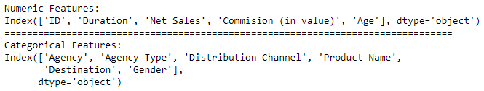
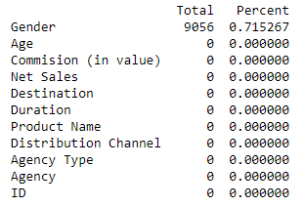
Exploratory Data Analysis
Continuous And Categorical Features
Missing Data

Slide 7
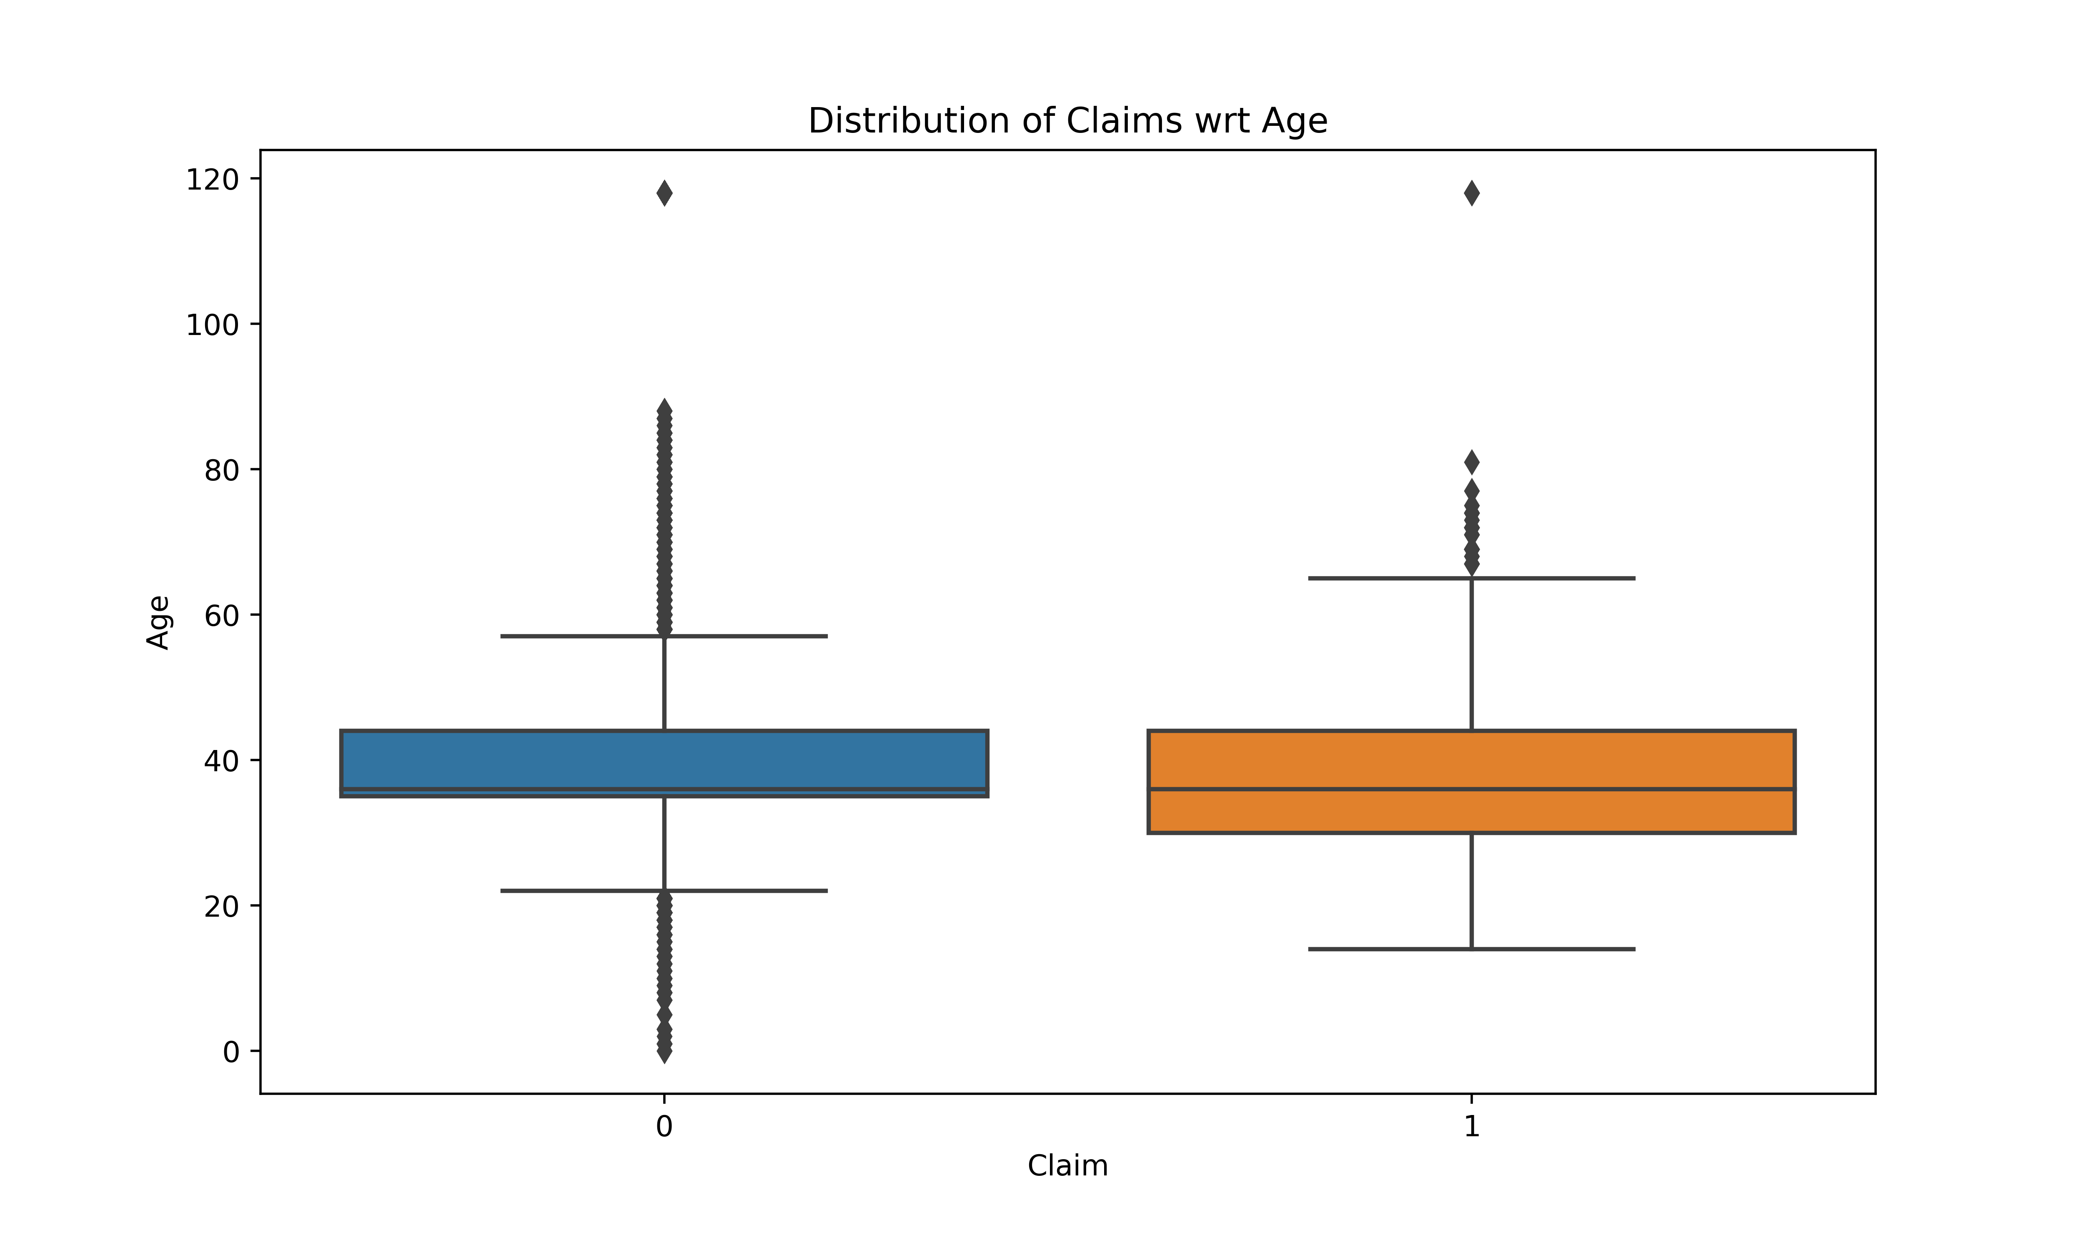
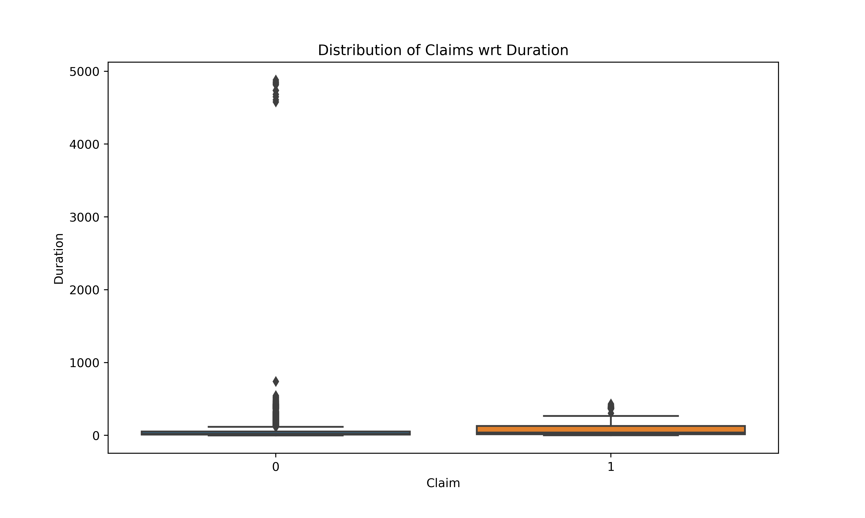
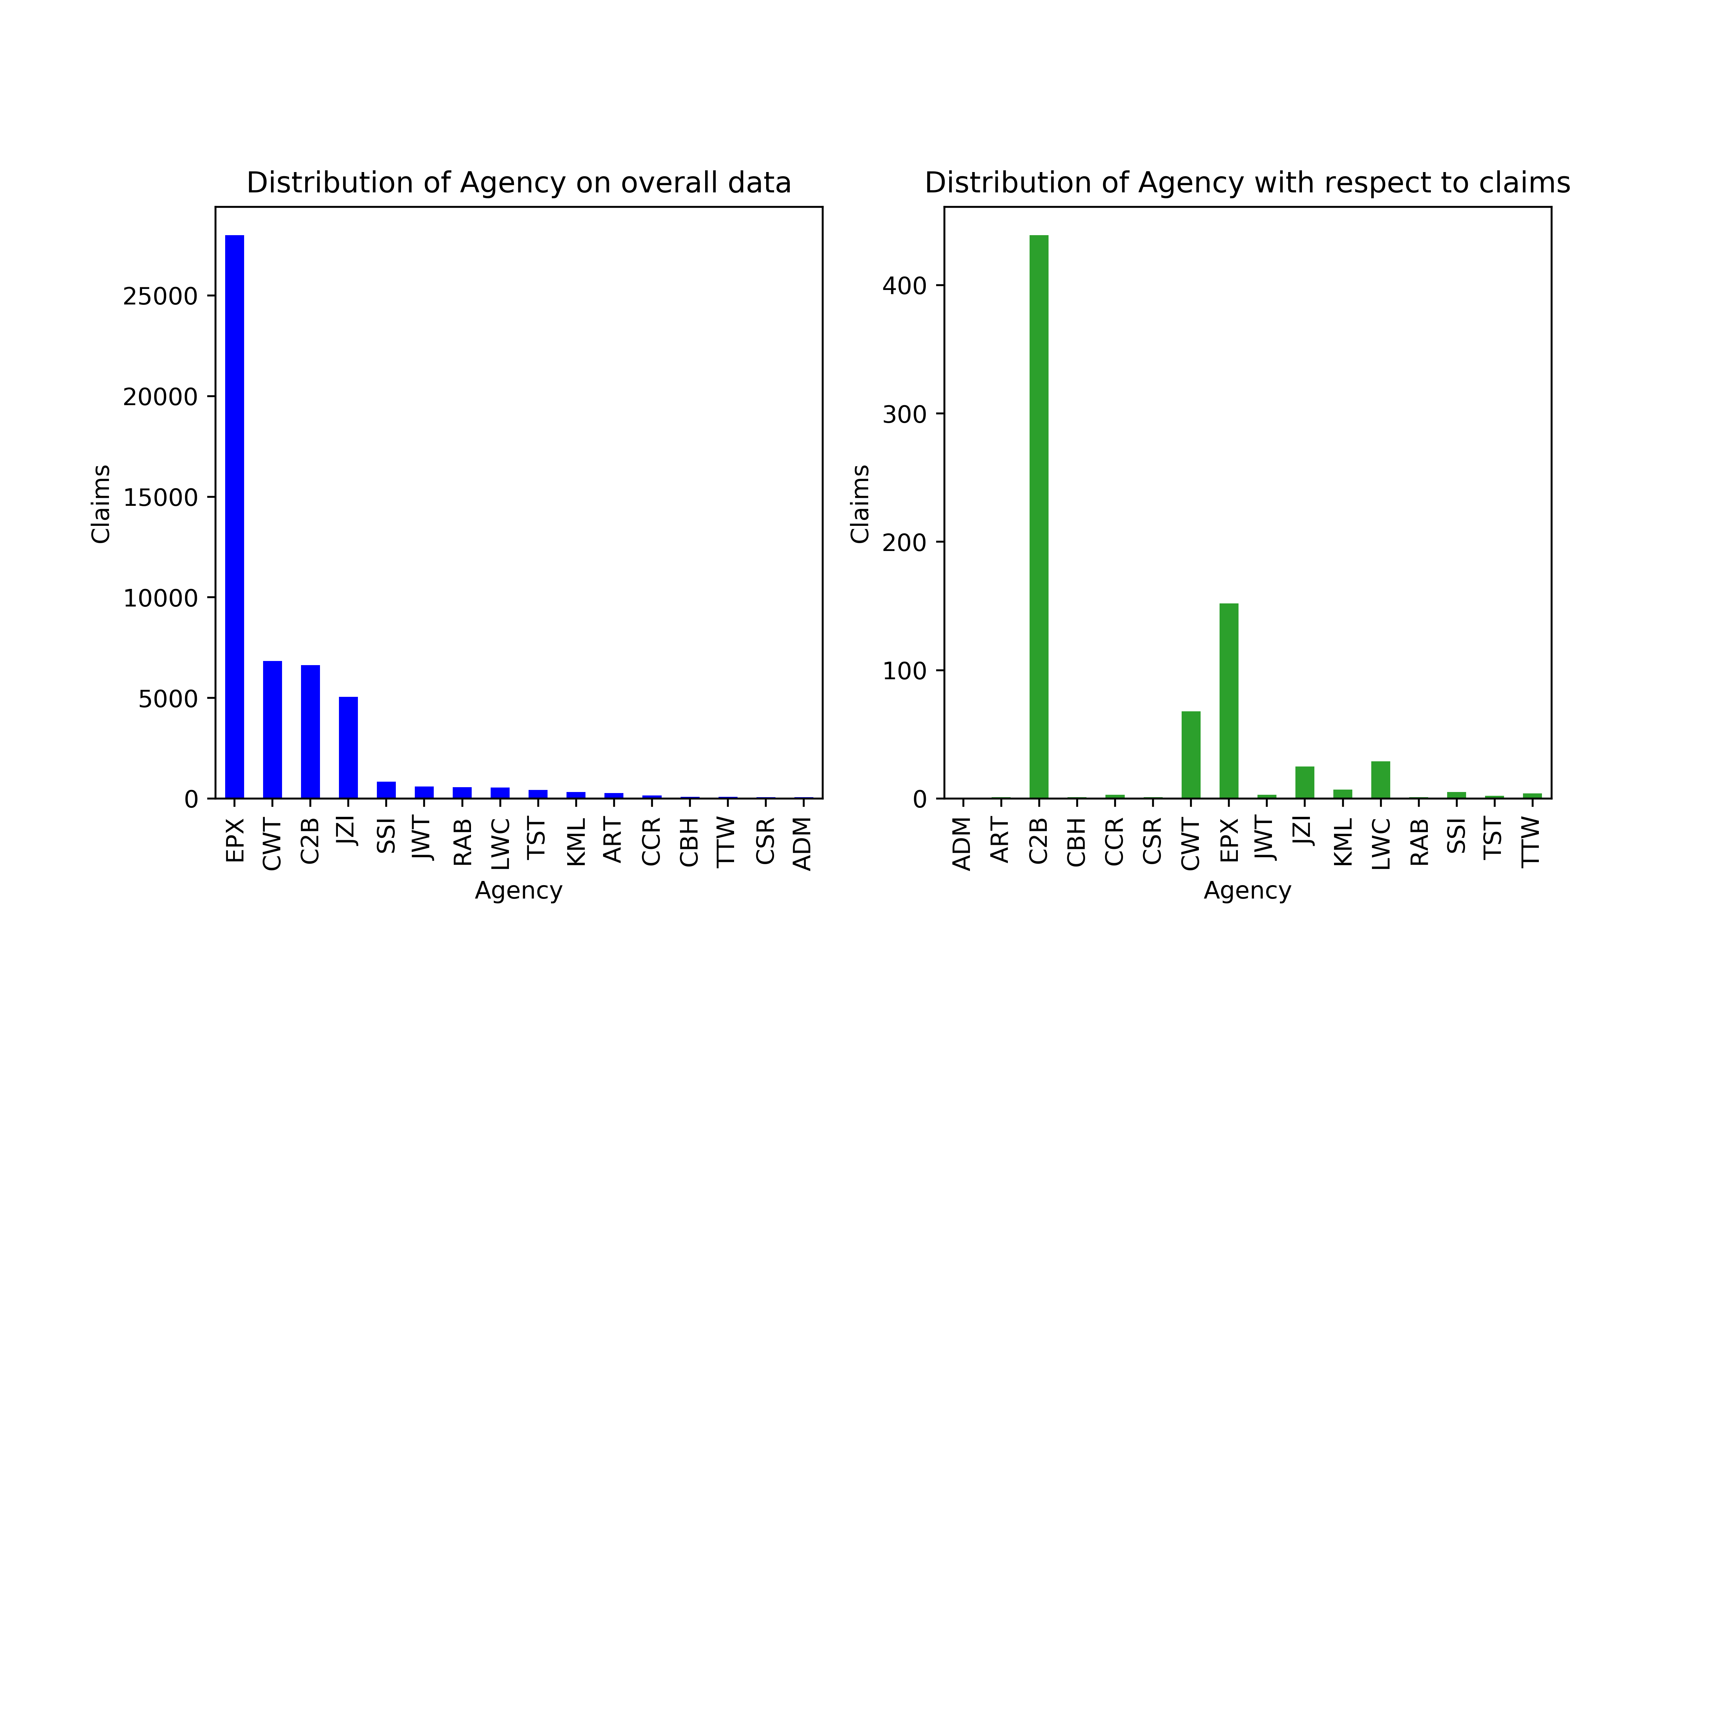
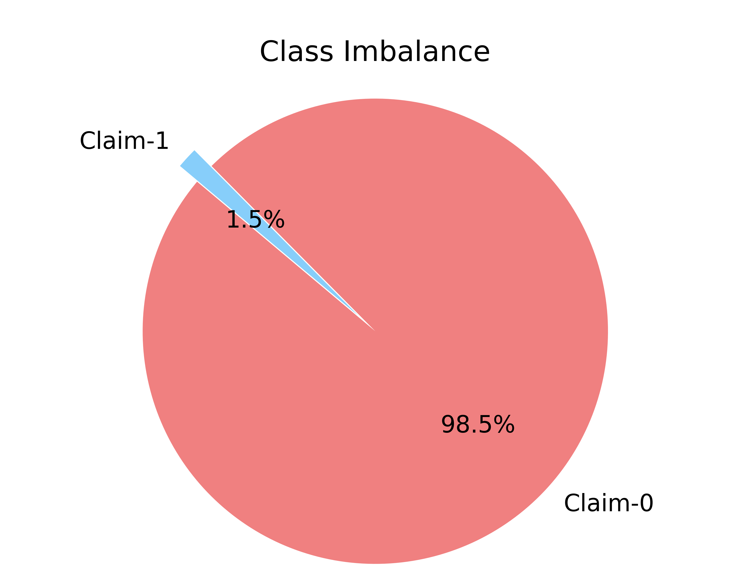

Slide 13
Skewness
After EDA

Slide 14
Pipeline
Data Cleaning
Age
Data Preprocessing
Encoding
Gender
ID
LabelEncoder
Scaling
RobustScaler
SMOTE
Duration
Notes:
Robust Scaler bcus

Slide 15
Models and Approaches
Base Model
Logistic Regression (due to Classification problem)
Final Model
XGBOOST
What are the different models you tried?
DecisionTree, RandomForest, XGBoost
For the best performing model, any insights on why it performed well.
Customization of optimum objectives.
Built in Cross-Validation
Automatic Tree Pruning

Slide 16
Model Tuning
Feature Selection / Feature Engineering
Recursive Feature Elimination
Hyperparameter Tuning
Grid Search on LogisticRegression
Grid Search on Random Forest
XGBoost

Slide 17
Feature Selection
Logistic Regression | DecisionTree | RandomForest
Agency | Agency | Agency
Agency type | Product_Name | Product_Name
Distribution Channel | Duration | Duration
Durtaion | Destination | Destination
Net_sales | Net_Sales | Net_Sales
Commission in values | Commission in values | Commission in values
Age | Age | Age
Applying RFE:
Agency_Type was removed

Slide 18
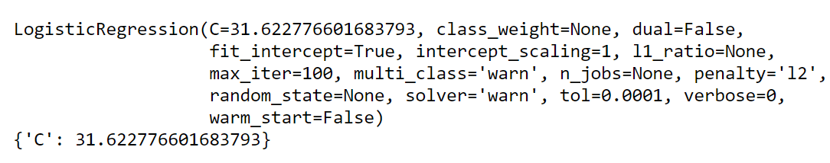
Hyperparameter Tuning
Grid Search on LogisticRegression
Grid Search on RandomForest
XGBoost
Learning_rate = 0.1, scale_pos_weight= 3

Slide 19
Evaluation & Results
Evaluation Metric | Logistic Regression |  | Decision Tree | Random Forest |  | XGBoost
 | Without SMOTE | With SMOTE | With SMOTE | Without SMOTE | With SMOTE | With SMOTE
Precision | 0.0 | 79% | 96% | 7% | 83% | 66%
Recall | 0.0 | 66% | 96% | 74% | 80% | 96%
F1-Score | 0.0 | 72% | 96% | 52% | 82% | 78%
Accuracy | 98% | 74% | 96% | 90% | 80% | 73%

Slide 20
Final Results
True Positives : 9486
True Negatives : 5099
False Positives : 4944
False Negatives : 396
Recall Score on Glabs – 90%
Evaluation Metric | Logistic Regression | Decision Tree | Random Forest | XGBoost
Recall | 66% | 96% | 80% | 96%

Slide 21
Insights
Provide more data on Claims to reduce data imbalance.
More data required on granular level for Offline channels, uncommon Destinations.
The correct value for Gender should be provided.
Year of policy purchase , expiration, sum insured, premium amount should be provided.
Overall if the dataset is better the predications and the precision score can be improved

